Slide 1


openMSE Walkthrough
With Blue Shark Case Studies
Global Blue Shark MSE Workshop
14 – 16 October 2025
Rome, Italy
Tom Carruthers
Adrian Hordyk
www.bluematterscience.com
https://openmse.com/

Slide 2

MSE process
Closed-loop simulation
Operating model
Implementation model
Observation model
Performance metrics
Management Procedure
System uncertainties
OM conditioning
MP testing MSE results
Implementn. review / exceptional circumstances
Data
MP adopted
Candidate MPs

Slide 3
MSE process
Operating models
Management Procedures
MSE calculations & results
Performance metrics
Exceptional circumstances
Performance metrics
System uncertainties
OM conditioning
MP testing MSE results
Implementn. review / exceptional circumstances
Data
MP adopted
Candidate MPs

Slide 4
Operating models
# == Use Stock Synthesis Assessment as OM ====
# - From SS3 assessment directory ----
OM = SS2OM(‘C:/An_Assessment’)
# - From an r4ss output list ---------
SS_out = r4ss::SS_output(‘C:/An_Assessment’)
OM = SS2OM(SS_out)
# == Use Any Conditioned Model Outputs =======
jjmfit = jjm(pac_jack_mack_dat)
naa = get_numbers_at_age(jjmfit)
faa = get_F_at_age(jjmfit)
waa = get_weight_at_age(jjmfit)
Mataa = get_maturity_at_age(jjmfit)
Maa = get_M_at_age(jjmfit)
laa = get_length_at_age(jjmfit)
OM = Assess2OM(naa, faa, waa, Mataa, Maa, laa)
System uncertainties
OM conditioning
Data

Slide 5
2. Management Procedures
# == Reference MPs ================================
ref_MPs = c(‘CurC’, ‘NFref’, ‘FMSYref75’)
# == Make an Empirical MP =========================
myEMP = Emp # copy Emp MP
formals(myEMP)$Inds = c(2,4) # indices 2 and 4
formals(myEMP)$curI_2_target = 0.5 # current stock levels are half target
formals(myEMP)$I_fac = 1.5 # target F is 50% higher than current
formals(myEMP)$HCR_CP_B = c(0.5, 1) # Cntrl pts at 50%, 100% target
# == Model-Based MPs ==============================
SCA_4010 = make_MP(SCA, HCR40_10) # SCA with 40-10
MB_MPs = c(‘SCA_4010’, ‘Spict1’) # Also test SSSP
System uncertainties
OM conditioning
Data
Candidate MPs

Slide 6
3. MSE calculations & results
# == Do MSE calculations ==========================
# - Historical reconstruction / ref points ---
Hist = Simulate(OM)
# - MSE projection ---------------------------
MSE = Project(Hist, MP = c(ref_MPs, myEmp, MB_MPs))
System uncertainties
OM conditioning
MP testing MSE results
Data
Candidate MPs

Slide 7
4. Performance metrics
# == Metrics / Results Presentation ==
# - Output data ------------
MSE@SB_SBMSY
MSE@F_FMSY
MSE@Catch
# - Plotting routines ------
Splot(MSE) # Simple projection plot
Tplot(MSE) # Trade-off plot
# - Formal metrics ---------
LTY(MSE) # Long term yield
P100(MSE) # P(SB>SBMSY)
AAVY(MSE) # Average annual var yield
PGK(MSE) # P(SB>SBMSY & F < FMSY)
# - Slick App -------------
...
Performance metrics
System uncertainties
OM conditioning
MP testing MSE results
Data
Candidate MPs

Slide 8
# == Exceptional Circumstances =======
# - Posterior predicted data -----
MP = 1 # first MP
PPD = MSE@PPD[[MP]] # get PPD for MP
PPD@Cat # catch data
PPD@Ind # index data
PPD@CAL # catch-at-length
PPD@CAA # catch-at-age
# - ECP App ----------------------
...
4. Performance metrics
Performance metrics
System uncertainties
OM conditioning
MP testing MSE results
Implementn. review / exceptional circumstances
Data
MP adopted
Candidate MPs

Slide 9
openMSE Breakout Session

Slide 10
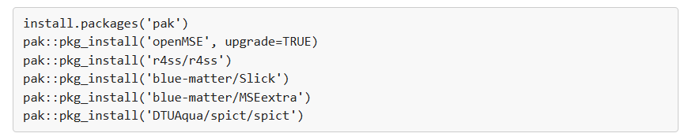
Prerequisite Software
Latest version of R
Latest version of Rtools
Recent version of RStudio
Packages:

Slide 11
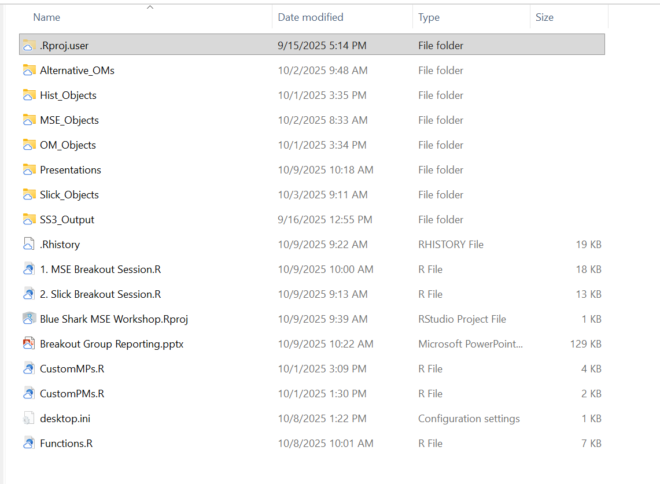
Breakout Session Material
Copy from Google Drive to Local Directory on your Machine

Slide 12
Breakout Session Material
SS3 Output Files
Copy from Google Drive to Local Directory on your Machine

Slide 13
Breakout Session Material
RStudio Project
Copy from Google Drive to Local Directory on your Machine

Slide 14
Breakout Session Material
Script for this breakout
Copy from Google Drive to Local Directory on your Machine

Slide 15
Breakout Session Material
Script for next breakout
Copy from Google Drive to Local Directory on your Machine

Slide 16
Breakout Session Material
Functions used in scripts
Copy from Google Drive to Local Directory on your Machine

Slide 17
Breakout Session Material
Reporting Ppt
Copy from Google Drive to Local Directory on your Machine

Slide 18
Breakout Session Material
Customizable MPs and PMs
Copy from Google Drive to Local Directory on your Machine

Slide 19
Breakout Session Material
Saved Objects
Copy from Google Drive to Local Directory on your Machine

Slide 20
1. MSE Breakout Session.R
Overview
Familiarize with openMSE code to run MSE and evaluate results
Run an (example) MSE for with OM based on stock assessment (SS3)
Define relevant PMs and evaluate results
Develop alternative OMs considering key uncertainties and run MSEs
Modify CMPs to improve performance and re-run models
Summarize final results

Slide 21
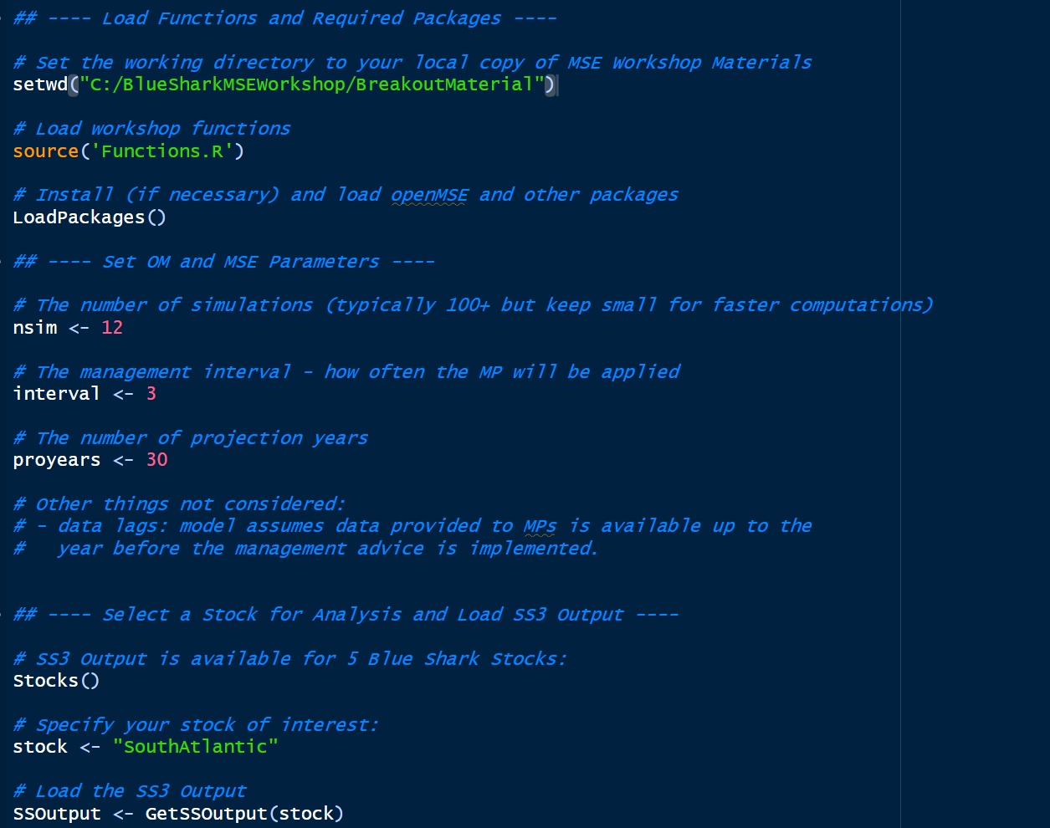
Setup
Set working directory to local copy
Load R packages 🤞
Number of simulations
Management interval
Number of projection years
Choose your stock
Import SS3 output as R list

Slide 22
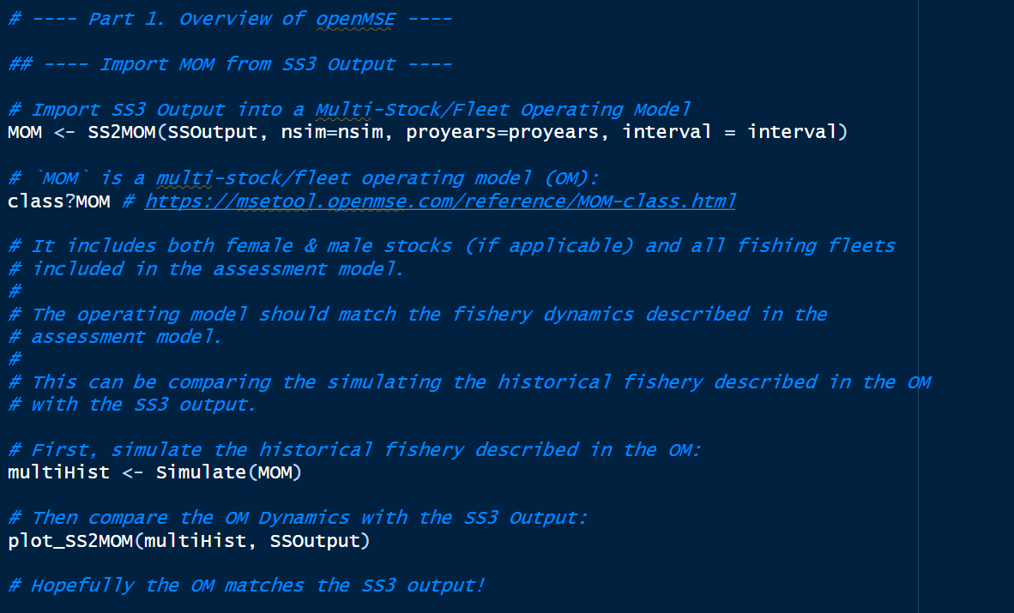
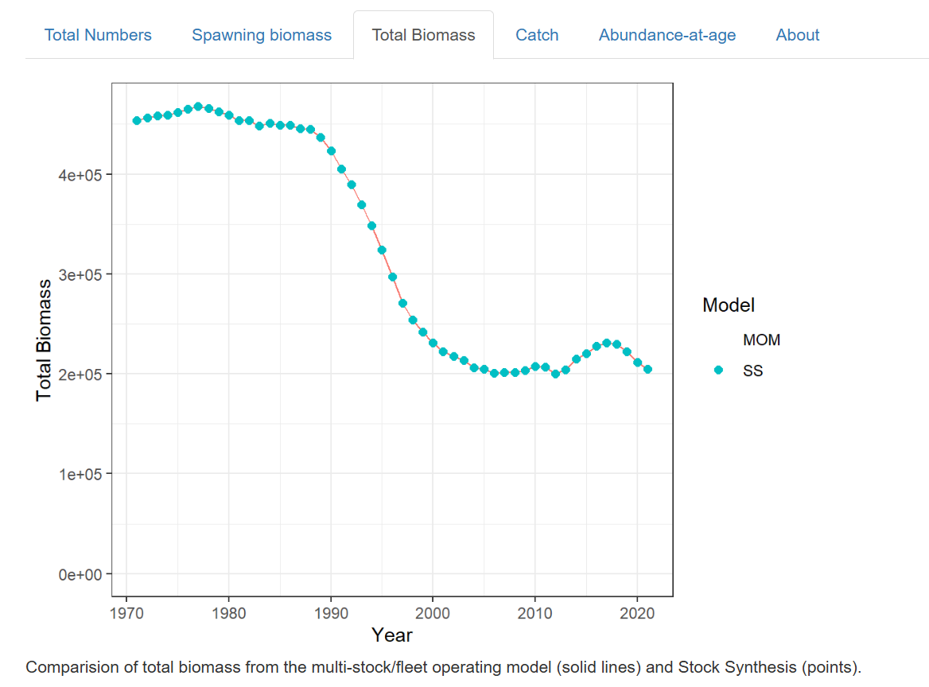
Part 1: Overview of openMSE Code and Features
Import OM from SS3 output and confirm fishery dynamics are reproduced

Slide 23
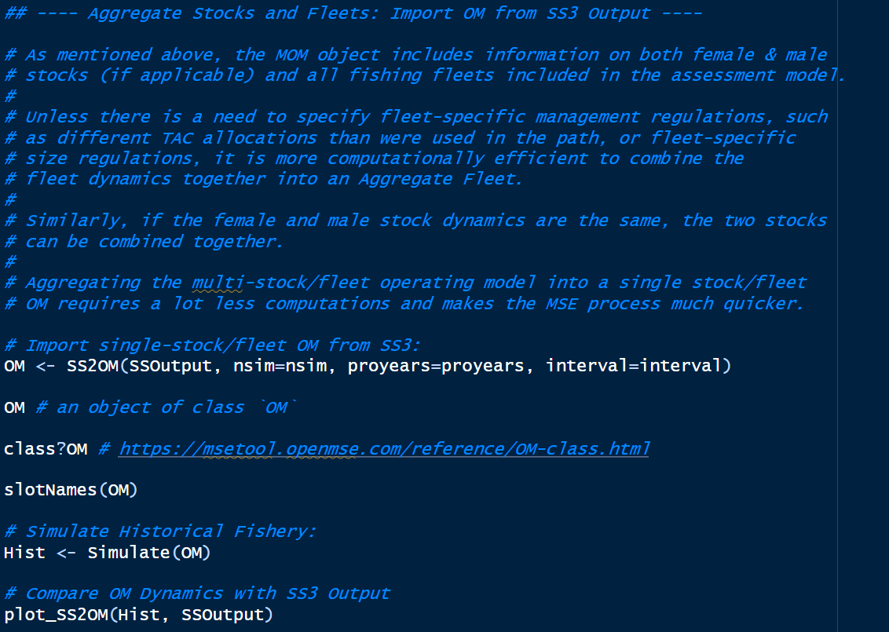
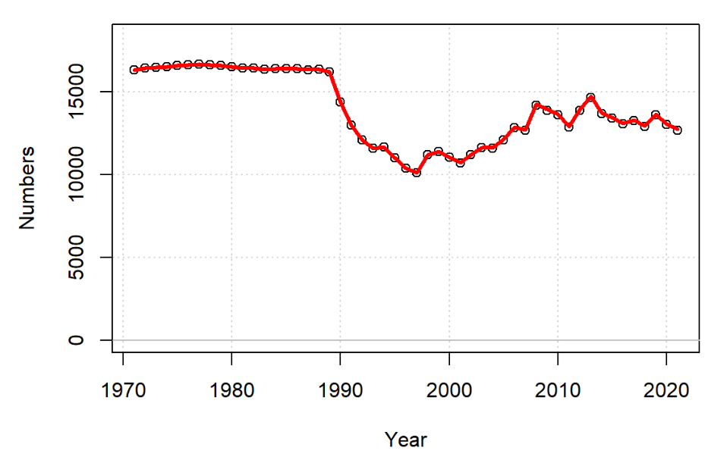
Part 1: Overview of openMSE Code and Features
Aggregate multi-stock (female & male) multi-fleet OM into single-stock/fleet OM
Much faster
Closely approximates fishery dynamics (except N. Pacific)
Same analysis can be repeated with MOM

Slide 24
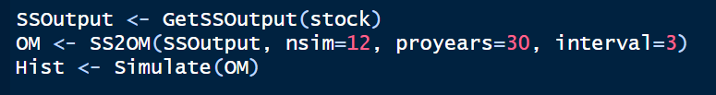
Part 1: Overview of openMSE Code and Features
Three lines of code:
Import SS3 Output
Import OM from SS3 Output (single-stock/fleet in this case)
Reconstruct historical fishery

Slide 25
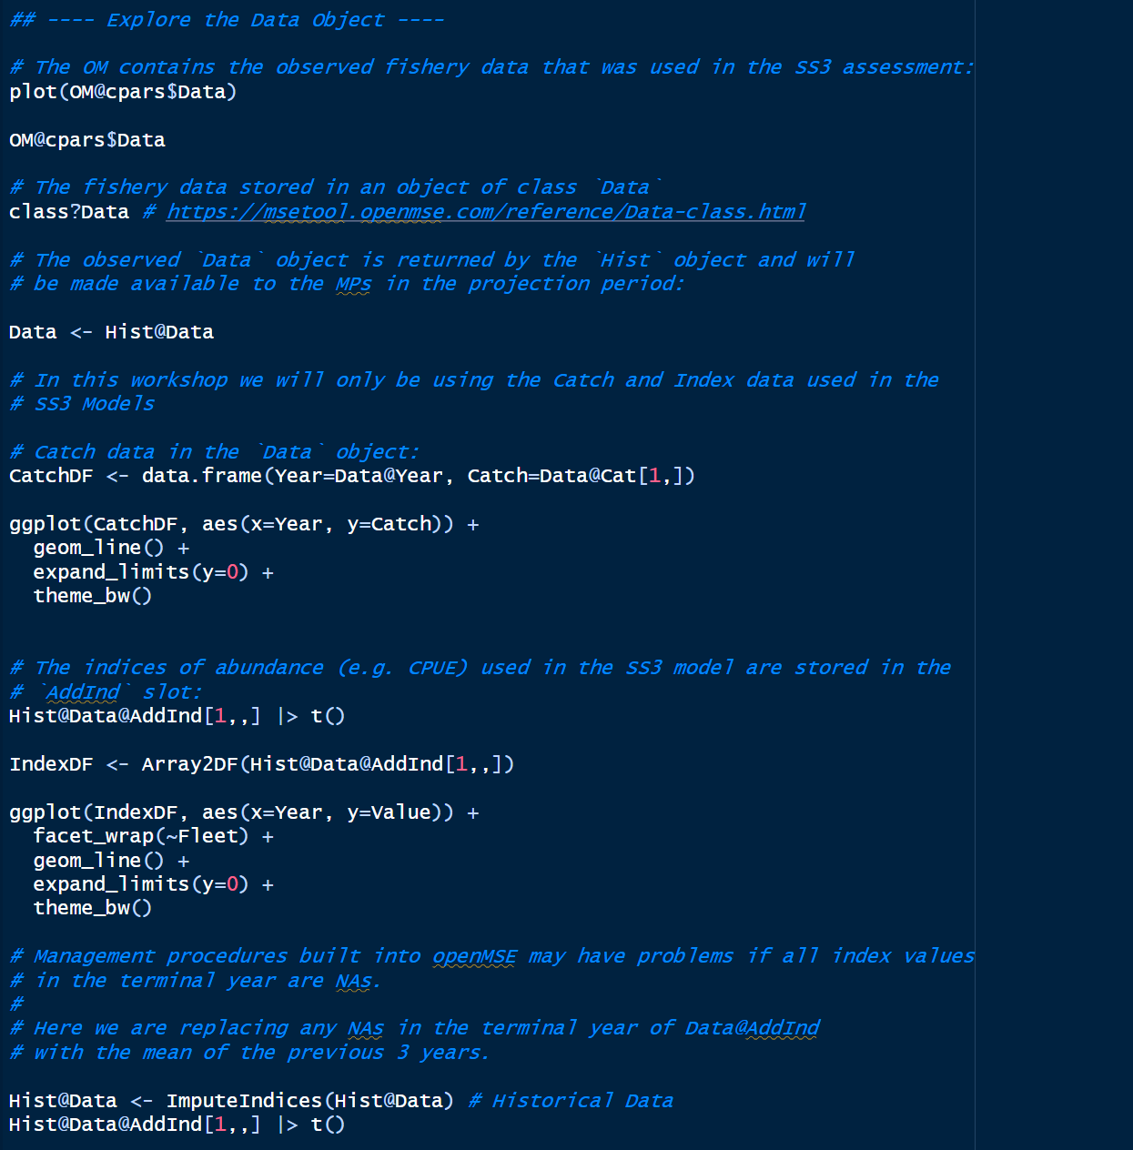
Part 1: Overview of openMSE Code and Features
Explore Data Object:
Observed data for historical period
Simulated data in projections (nsim versions)

Slide 26
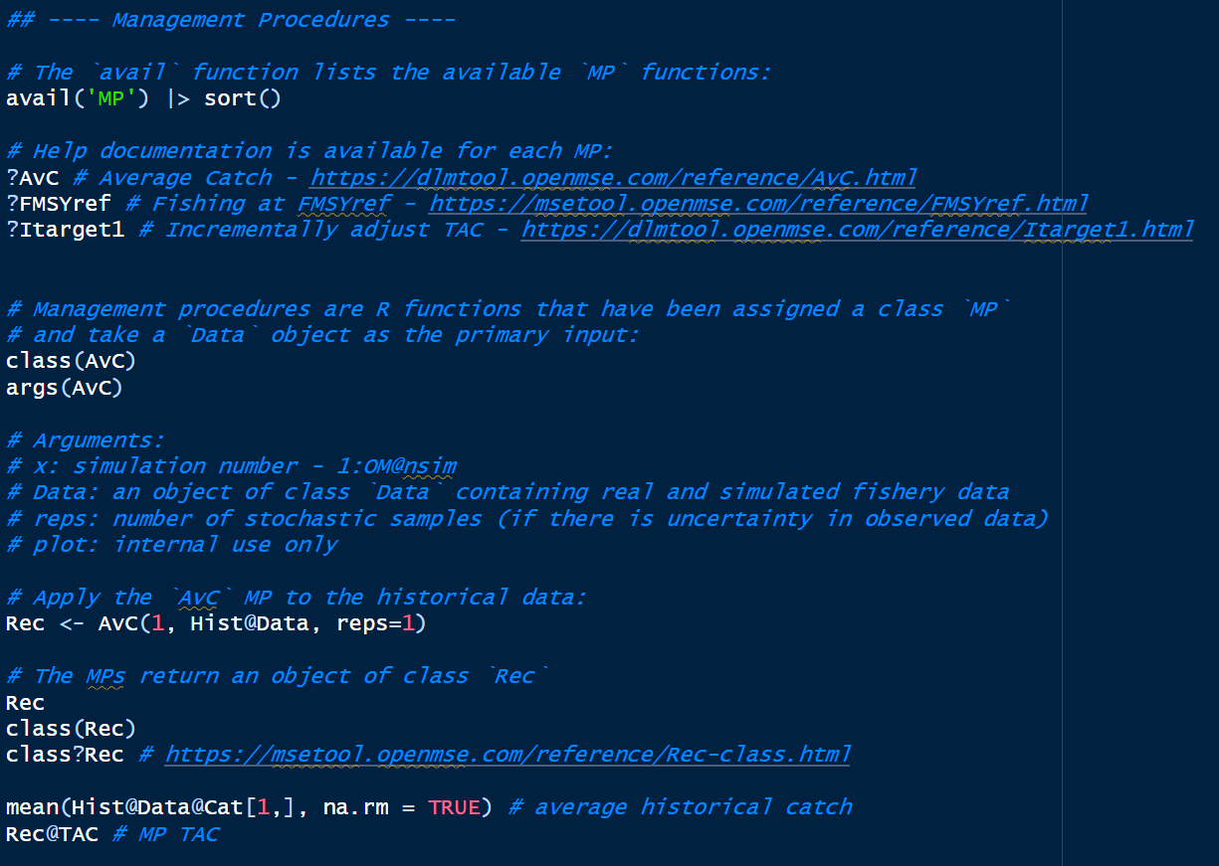
Part 1: Overview of openMSE Code and Features
Explore Management Procedures:
MPs: R functions applied to Data objects to produce management recommendations (Rec objects)
openMSE uses S4 objects: access slots with @
Relatively simple CMPs included in openMSE
Later: develop custom MPs

Slide 27
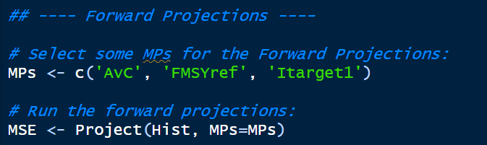
Part 1: Overview of openMSE Code and Features
Forward Projections:
Select MPs
Project Hist object forward

Slide 28
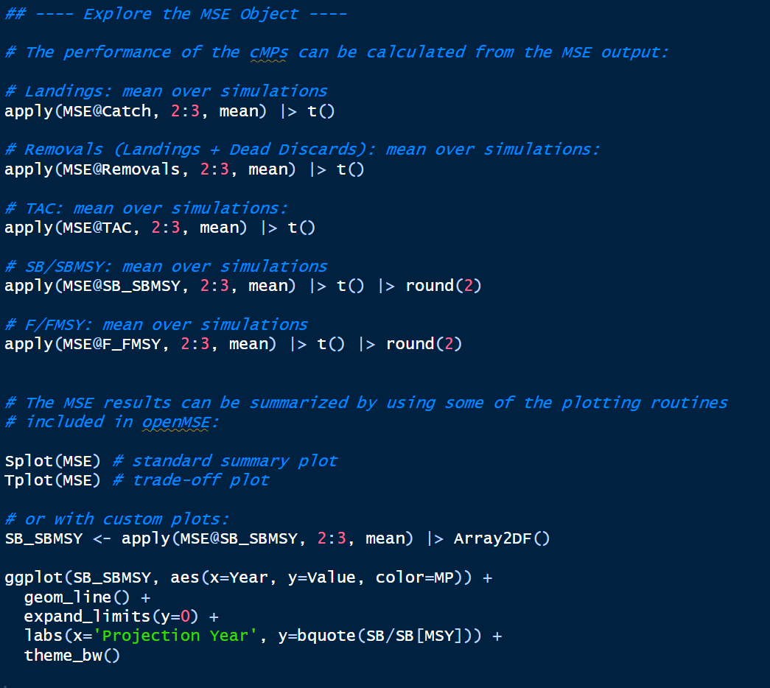
Part 1: Overview of openMSE Code and Features
Explore MSE Output:
Calculate statistics
Summary plots
Custom plots

Slide 29
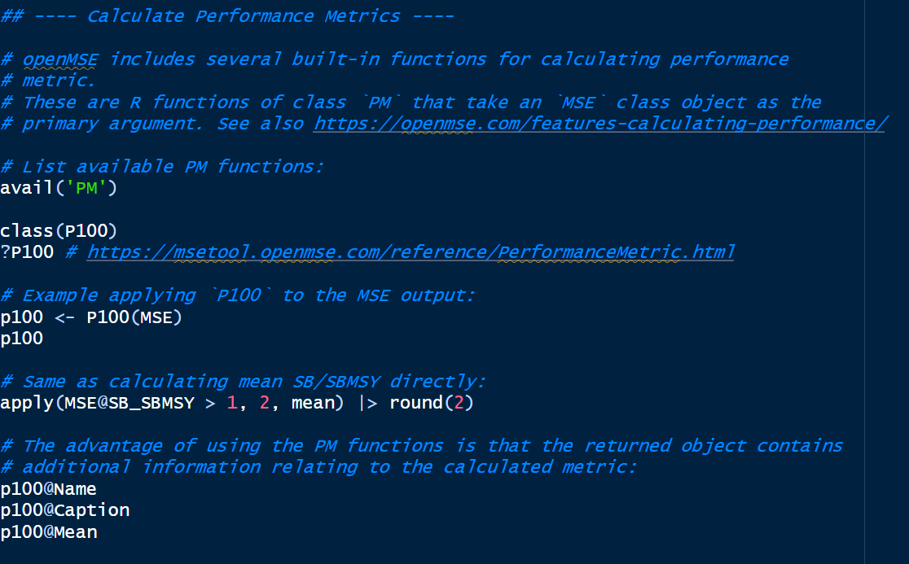
Part 1: Overview of openMSE Code and Features
Calculate Performance Metrics:
PM functions included in openMSE
Summary statistics

Slide 30
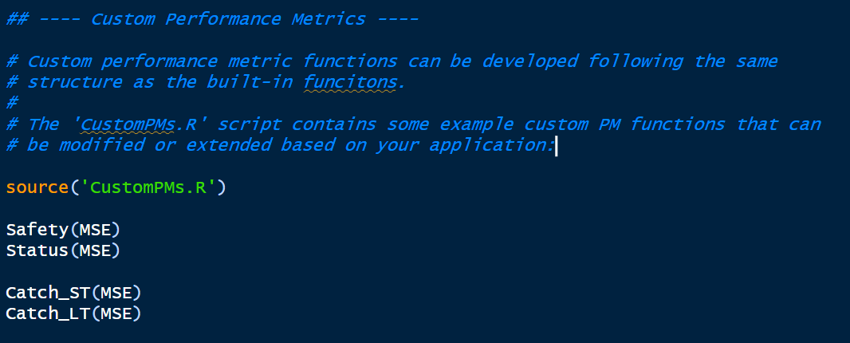
Part 1: Overview of openMSE Code and Features
Custom Performance Metrics:
CustomPMs.R
Modify or Add as needed

Slide 31
Part 2: Blue Shark Case Study – Base Case

Slide 32
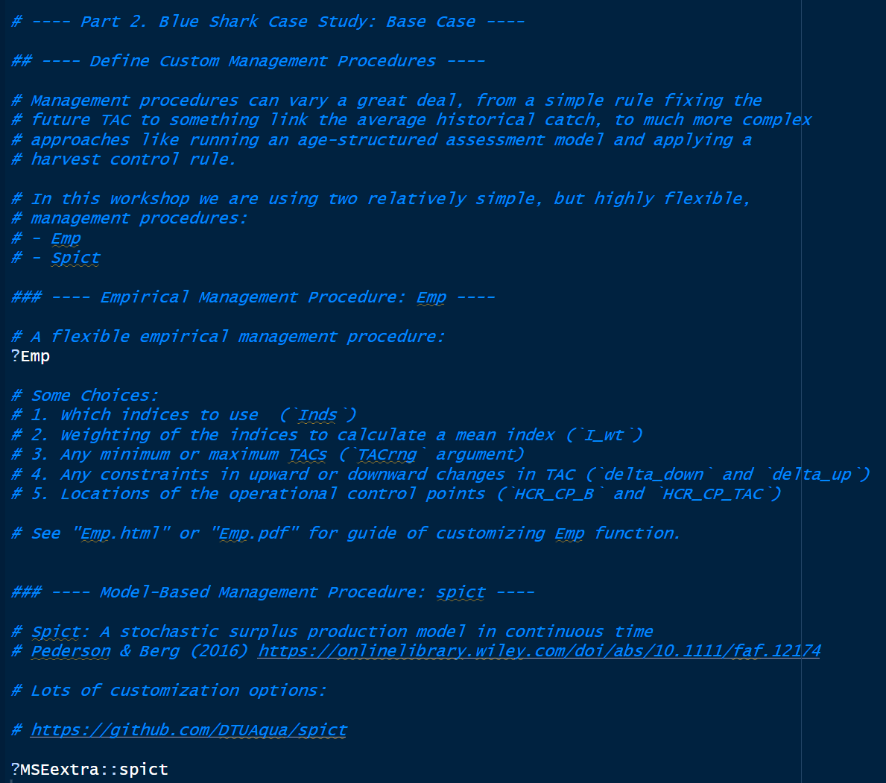
Part 2: Blue Shark Case Study – Base Case
Custom Management Procedures:
Two example MPs:
Emp
Spict
Modify in CustomMPs.R

Slide 33
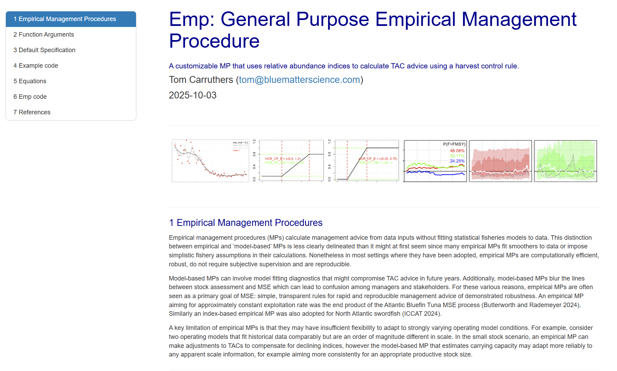
Part 2: Blue Shark Case Study – Base Case
Emp
Flexible Empirical MP
Two versions included in CustomMPs.R
Modify or Add as needed
Guide for customizing Emp

Slide 34

Part 2: Blue Shark Case Study – Base Case
Spict
Stochastic surplus production model in continuous time (Pederson & Berg 2016)
Two versions included in CustomMPs.R
Modify or Add as needed

Slide 35
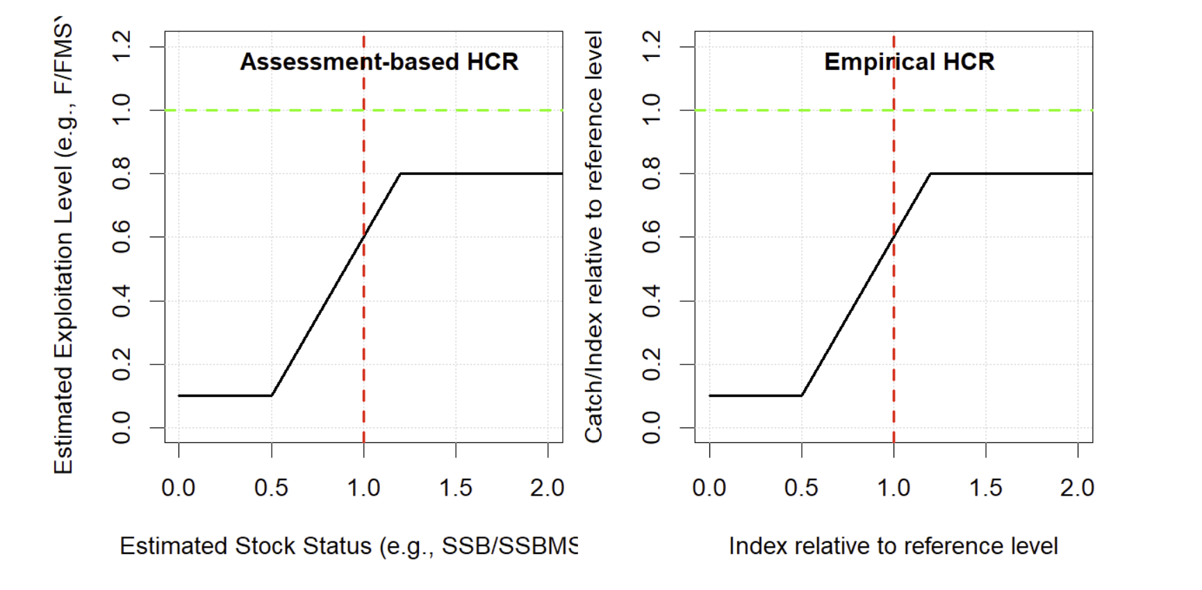
Emp: general-purpose empirical MP
Calculates TACs based on relative abundance index data.
Can incorporate an empirical harvest control rule.
HCR calibration is based on recent (current) index levels and catch rates.

Slide 36
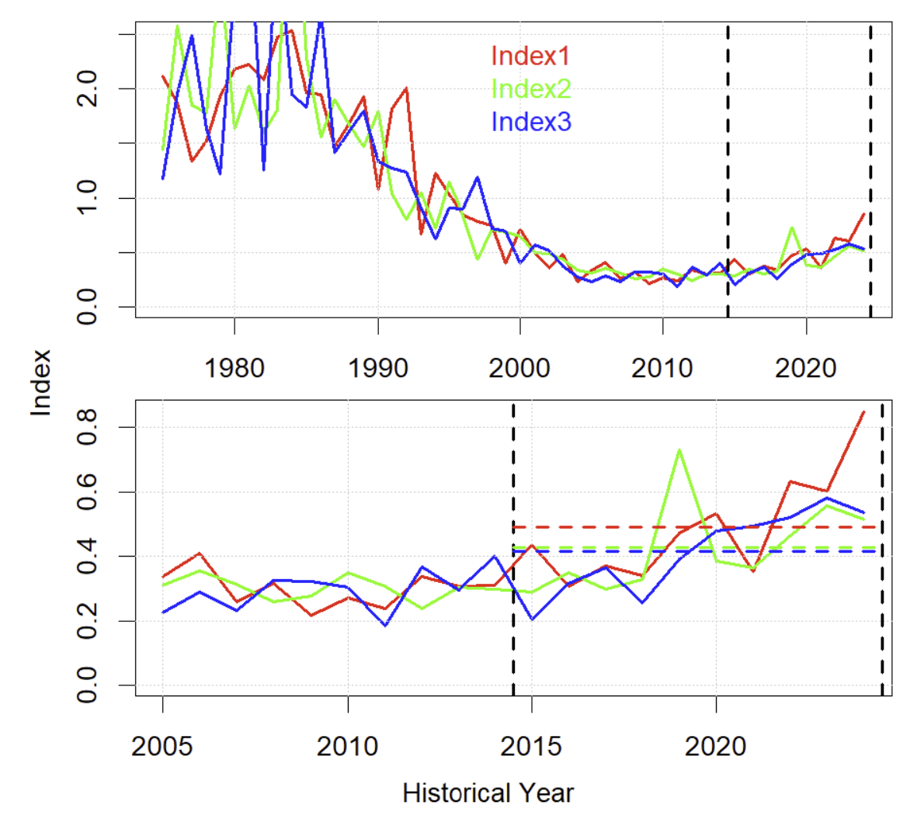
Calibration (Ind_fac, curI_2_target, calib_yrs)
calib_yrs = 10
‘recent index levels are approximately half SSBMSY’
curI_2_target = 0.5
‘recent catch rates are approximately four times FMSY’
Ind_fac = 1/4
The definition of ‘recent’ is a certain number of years (calib_yrs) of the recent historical time series (observed data)

Slide 37
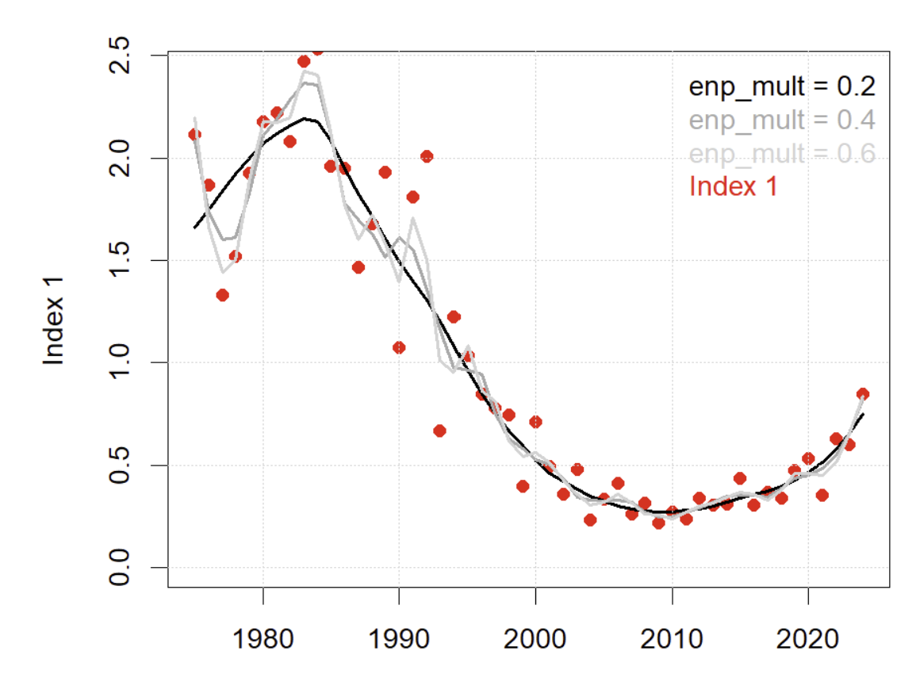
Index smoothing (enp_mult)
Indices are smoothed in an attempt to separate signal from noise.
The parameter enp_mult alters the number of smoothing parameters (p) in a polynomial smoother.
Parameterized as a multiplier of index length in order to maintain the same degree of smoothing as the length of the index (l) increases under projections (p = l * enp_mult).
The appropriate value of enp_mult depends on the natural variability and observation error of the individual case.

Slide 38
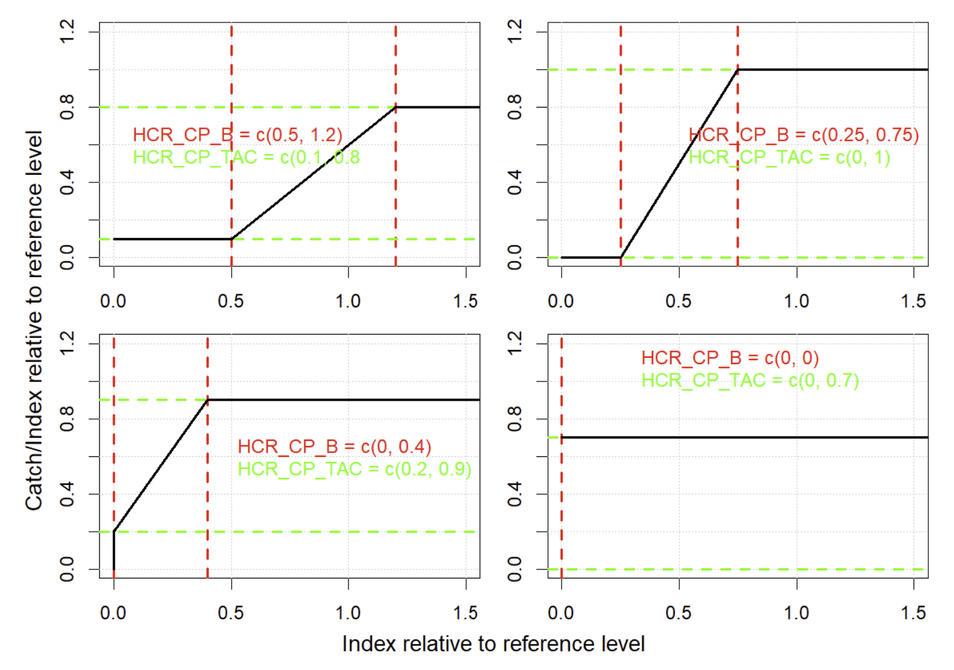
Control points (HCR_CP_B, HCR_CP_TAC)

Slide 39
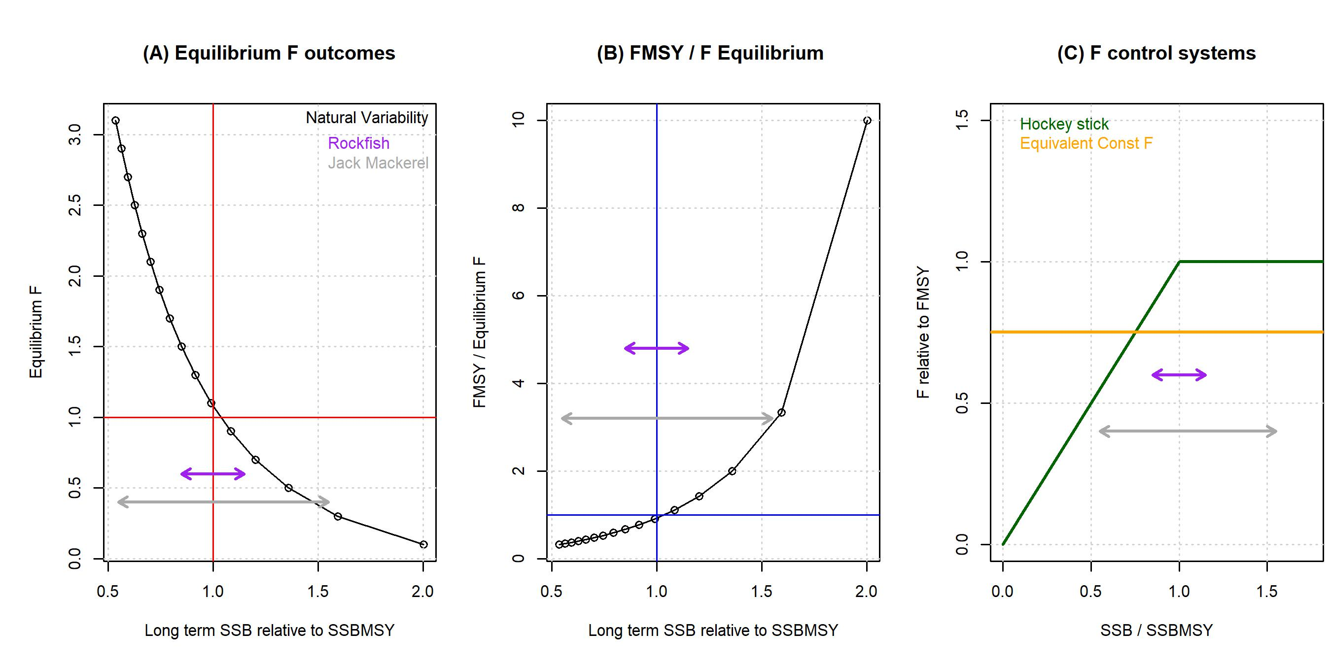
Catch equivalency of F control systems
Equivalent aggressive hockey stick

Slide 40
Additional TAC controls
Absolute limits: TACrng
TACrng = c(10, 1000) # between 10 kg and 1 tonne
Downward change: delta_down
delta_down = c(0.01, 0.5) # between 1% and 50%
Upward change: delta_up
delta_up = c(0.02, 0.25) # between 2% and 25%
TAC change dampener: resp
TAC_{ratio} = TAC_{proposed} / TAC_{old} # TAC_{proposed} is that from the HCR
TAC_{new} = TAC_{old} * exp(ln(TAC_{ratio}) * resp)
resp = 1 # proportional
resp = 0.5 # changes are dampened substantially

Slide 41
In code
?Emp # Emp in-line help
myEmp = Emp # Copy Emp MP
Hist@Data@AddInd # Take a look at your index data
formals(myEmp)$Inds = c(1,4) # Uses indices 1 and 4
formals(myEmp)$calib_yrs = 5 # ‘Current’ is most recent 5 years
formals(myEmp)$curI_2_target = 0.4 # Target biomass is 2.5x ‘current’ levels
formals(myEmp)$Ind_fac = 0.5 # ‘Currently’ fishing at twice target rate
formals(myEmp)$HCR_CP_B = c(0, 0.5) # Throttling of F below half target index
formals(myEmp)$HCR_CP_TAC = c(0, 1) # F is throttled to zero at zero index
formals(myEmp)$enp_mult = 0.4 # No. smoothing params is 40% index length
formals(myEmp)$resp = 0.5 # Damped TAC response
formals(myEmp)$delta_up = c(0.02, 0.1) # between 2 and 10% TAC increases
formals(myEmp)$delta_down = c(0.02, 0.15)# between 2 and 15% TAC decreases
formals(myEmp)$TACrng = c(0, 1E6) # Max TAC of 1kt
MSE = Project(Hist, c(‘Emp’, ‘myEmp’)) # Project default Emp and new myEmp

Slide 42
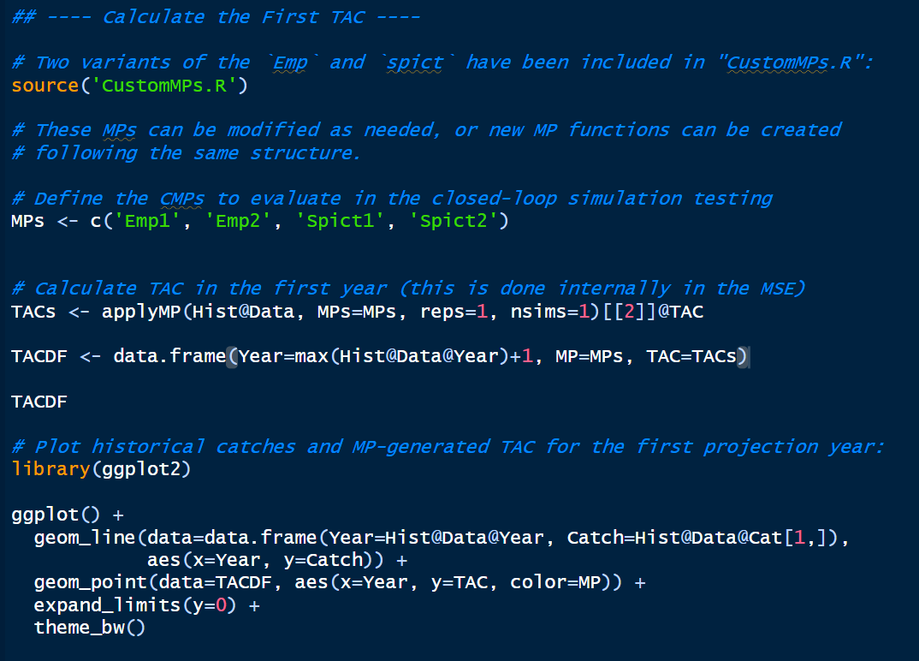
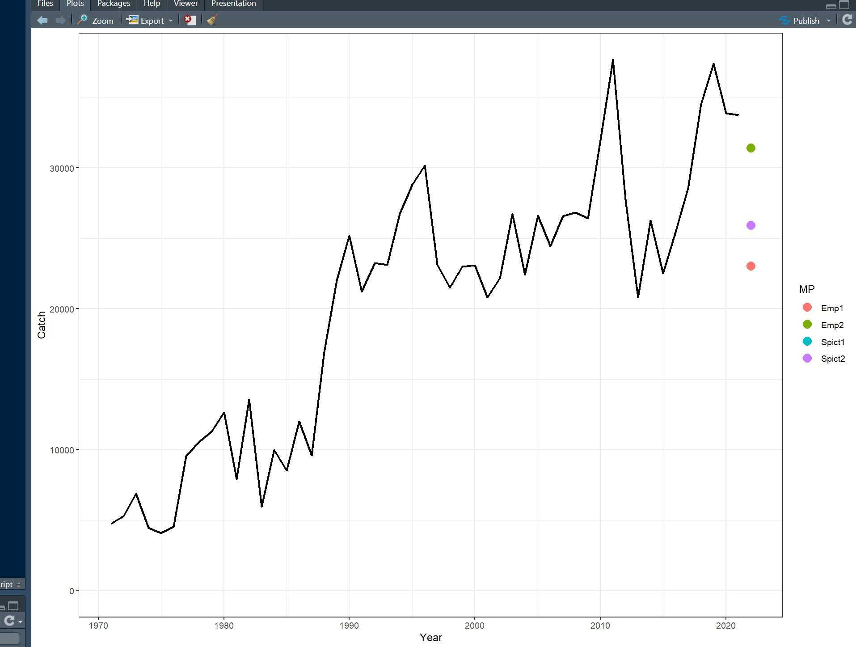
Part 2: Blue Shark Case Study – Base Case
Calculate First TAC:
Source CustomMPs.R
Select MPs
Calculate first TAC based on historical data
Modify CMPs as needed

Slide 43
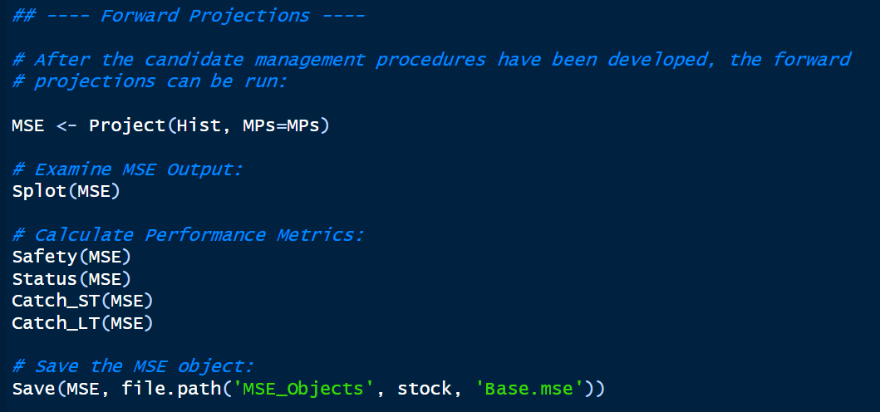
Part 2: Blue Shark Case Study – Base Case
Forward Projections
Run forward projections with selected MPs
Examine output
Calculate PMs
Modify MPs and re-run as needed
Save MSE object to disk

Slide 44
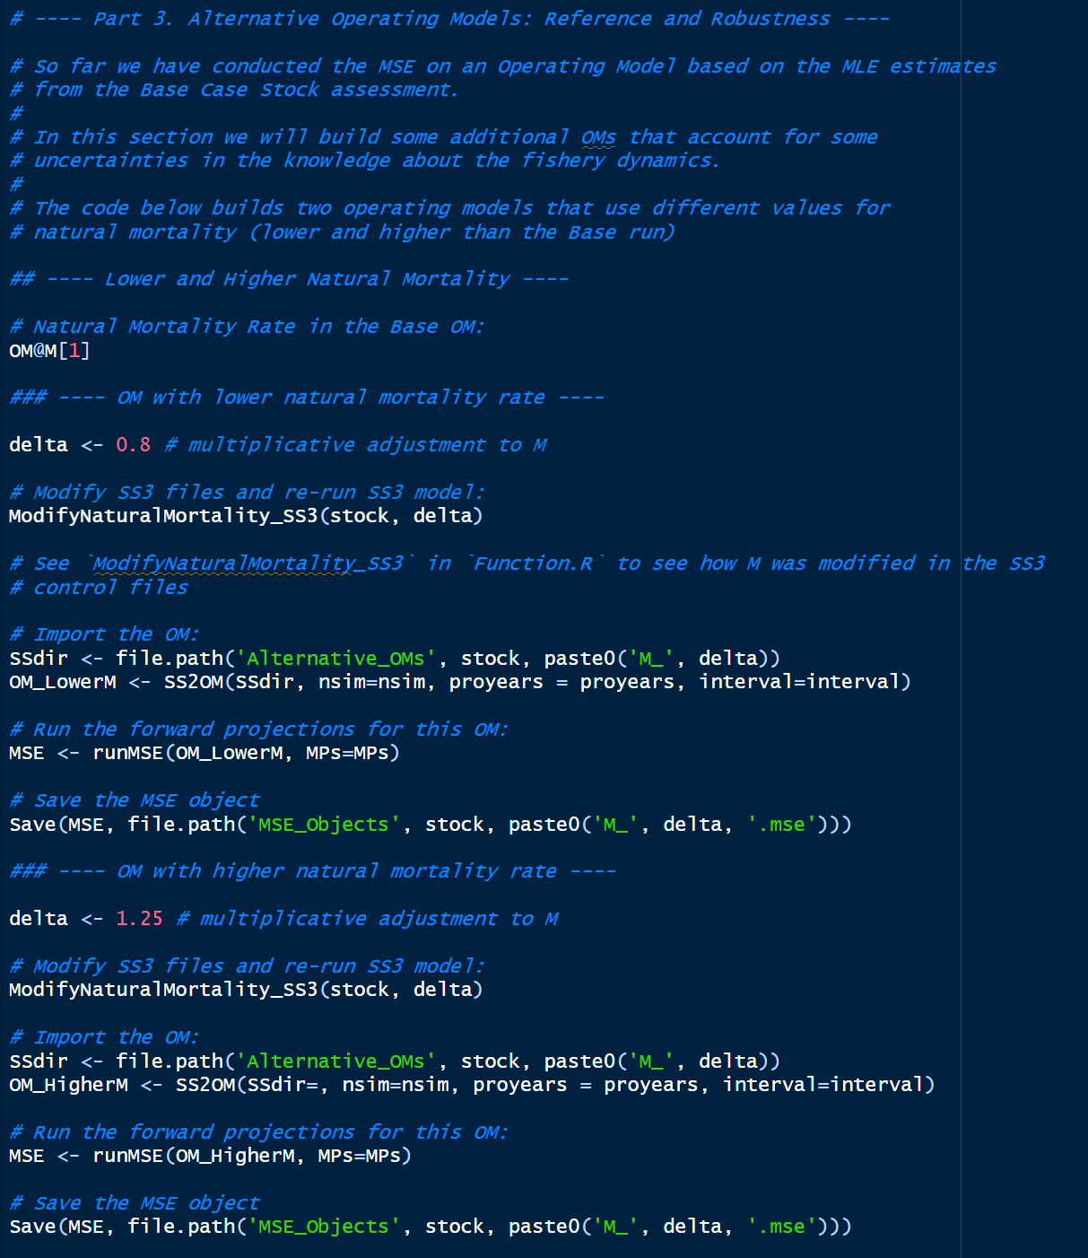
Part 3: Blue Shark Case Study – Alternative OMs
Alternative OMs:
Build additional OMs accounting for uncertainties
Example: decrease and increase in M
Modify code as needed
Steps:
Copy SS3 files to new directory
Modify parameters/data in SS3 files
Re-run SS3 model and import OM
Run MSE for new OMs
Save MSE objects
Steps 1 – 3 are done automatically by ModifyNaturalMortality_SS3()
Same process can be followed for additional uncertainties

Slide 45
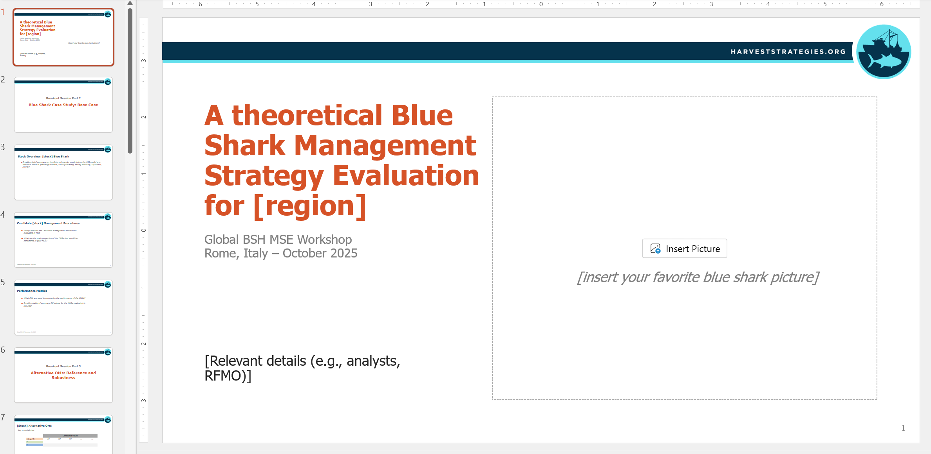
Reporting
Populate Reporting PowerPoint:
Overview of fishery dynamics of selected case study
Summary of the CMPs evaluated in the analysis
Summary of the PMs used to summarize CMP performance
Description of Alternative OMs
Figures and Tables summarizing Results (next session: Slick)

